Slide 1
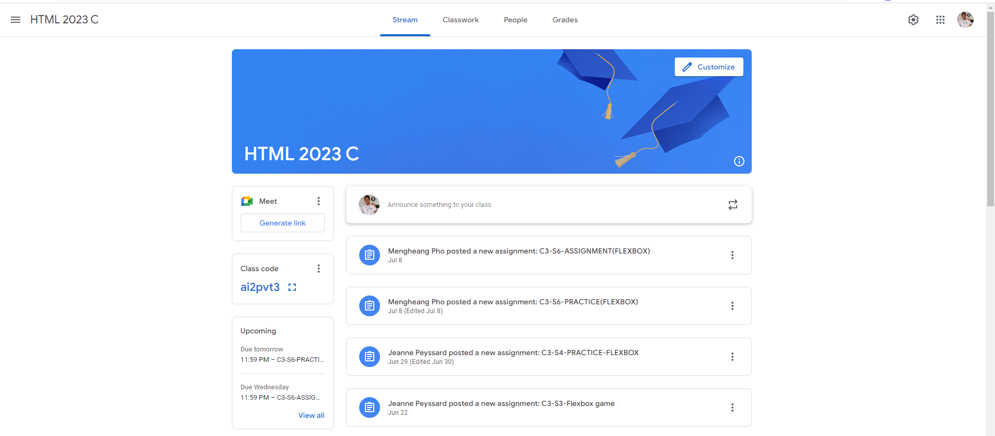

Slide 2
Main
Header

Slide 3
Header-left
Navigation
Header-right
Main-Content
Main-title

Slide 4
Side-Bar
Primary-Content

Slide 5
Content-block

